Slide 1
SUIT
IETF 104 Hackathon Report

Slide 2


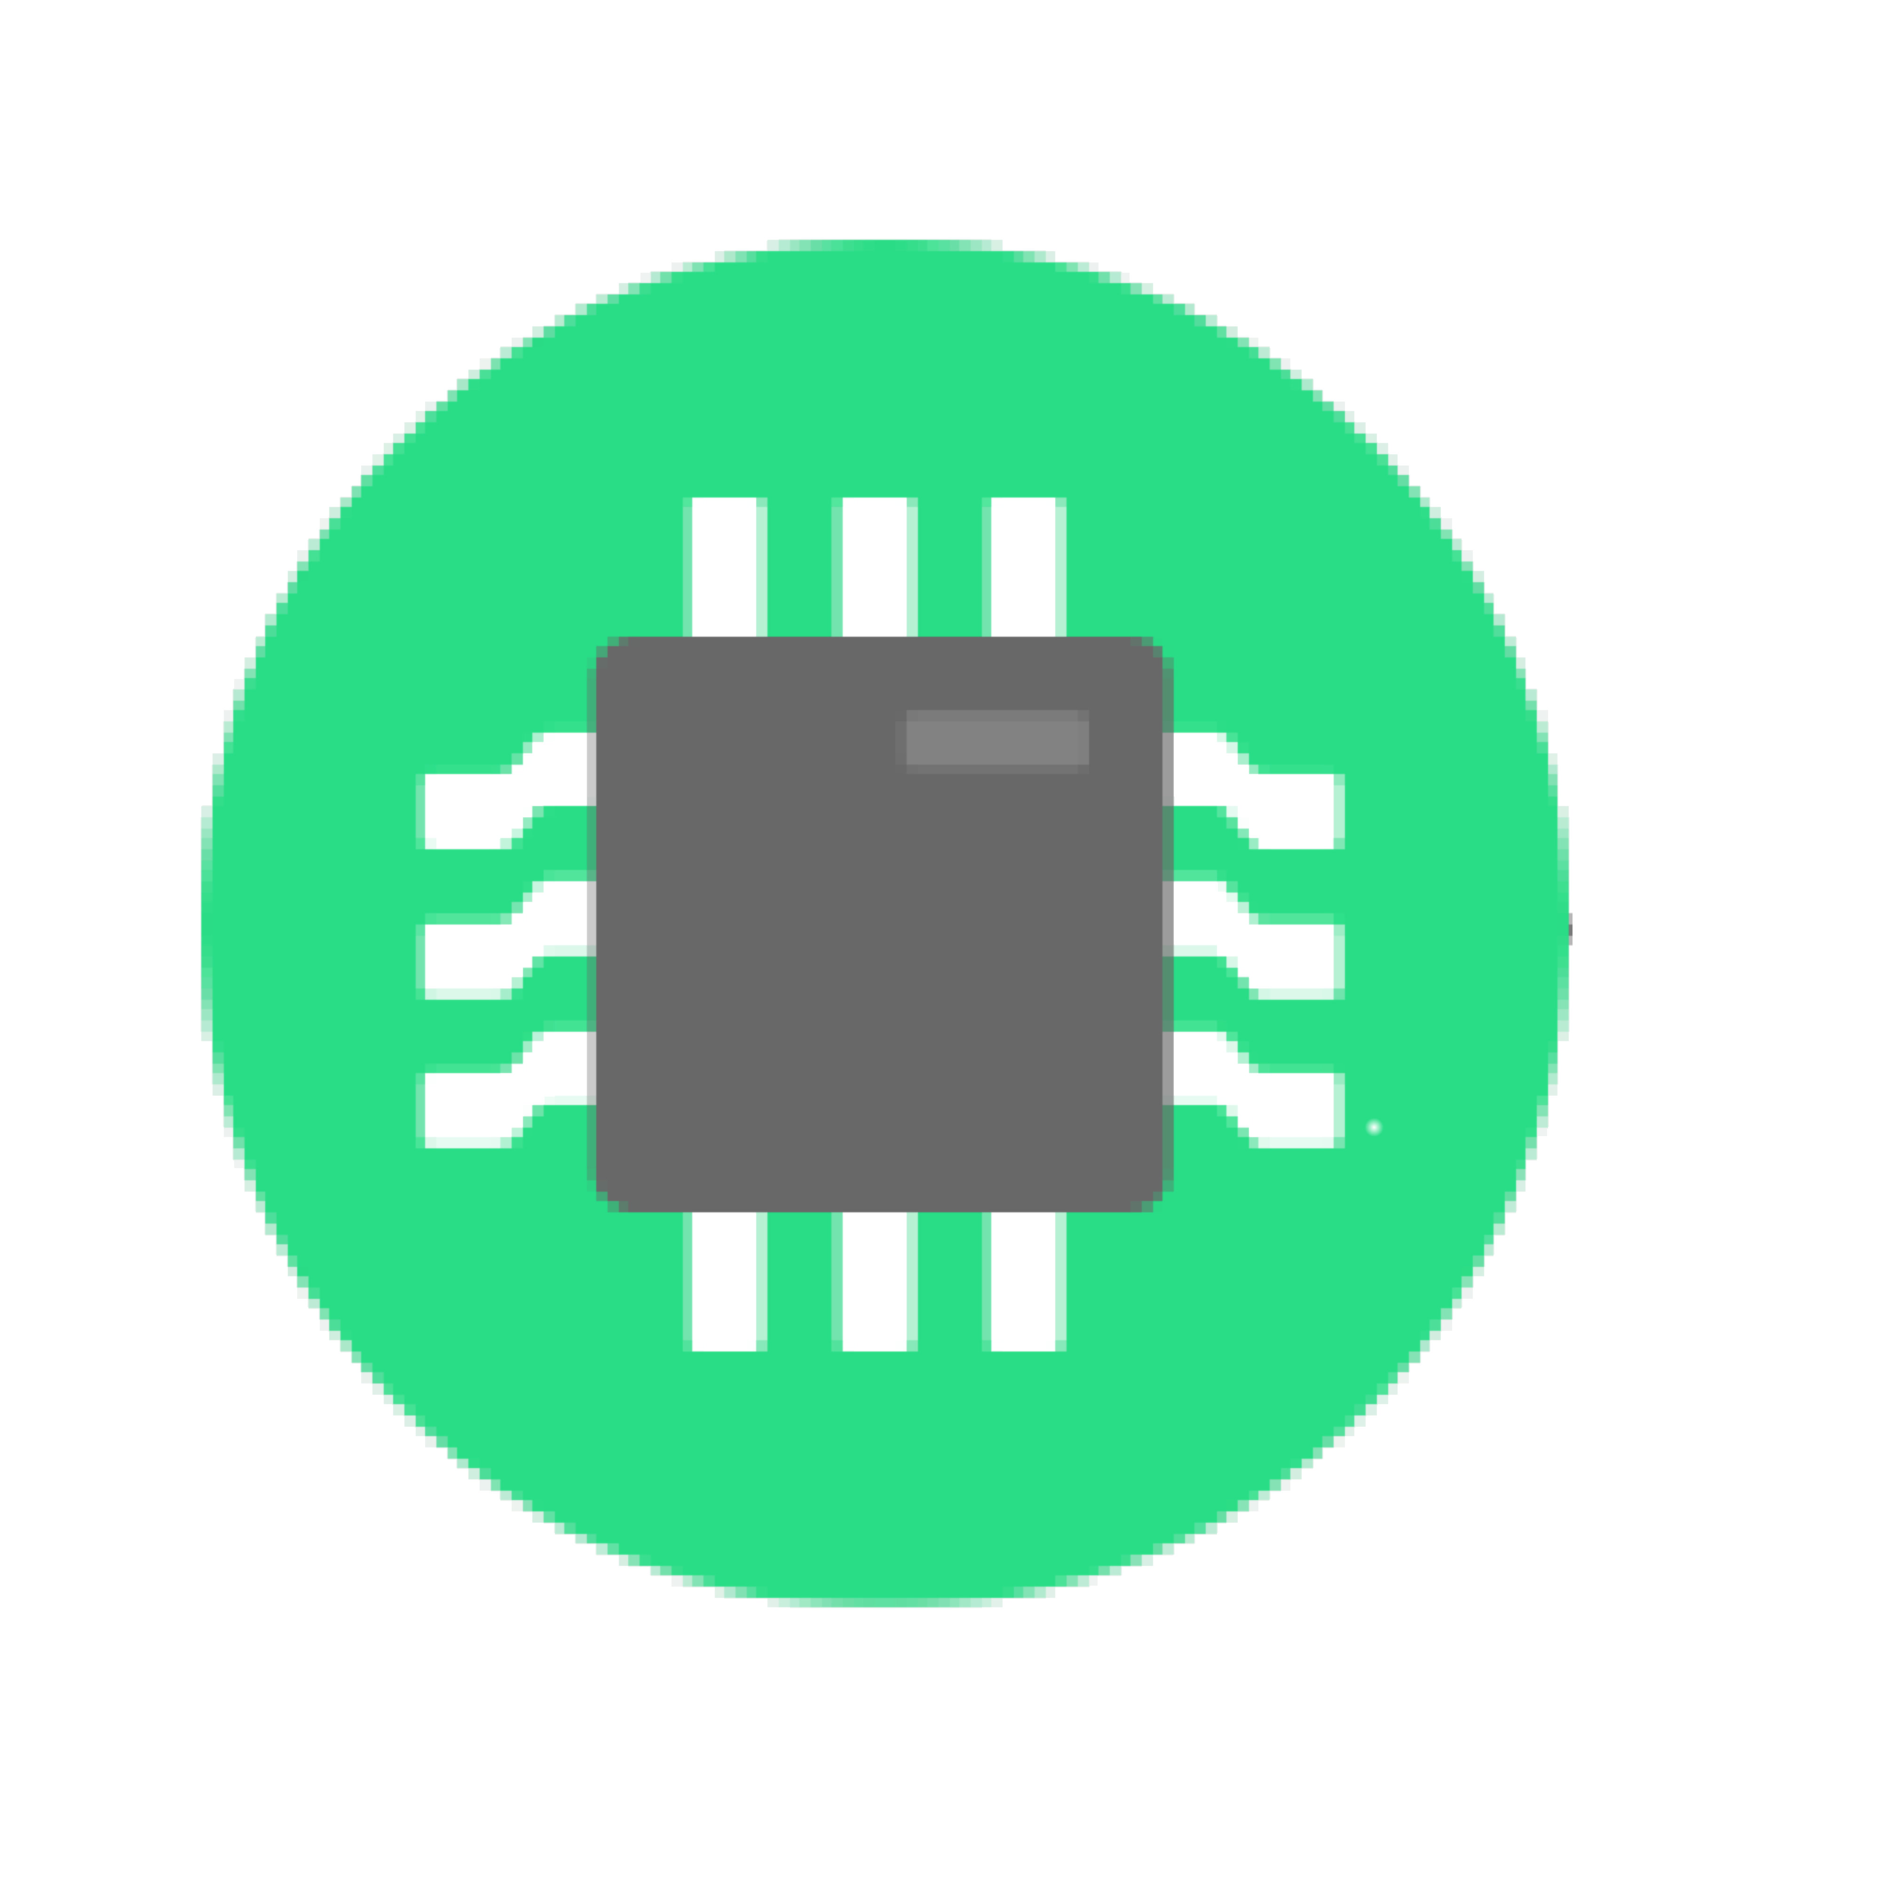
Software Update for IoT (suit)
Architecture & metadata for IoT firmware updates
also on small microcontrollers!
Hands-on work on latest metadata draft:
cbor manifest format
draft-moran-suit-manifest-04
IoT Software Maintainer
network
IoT Device

Slide 3
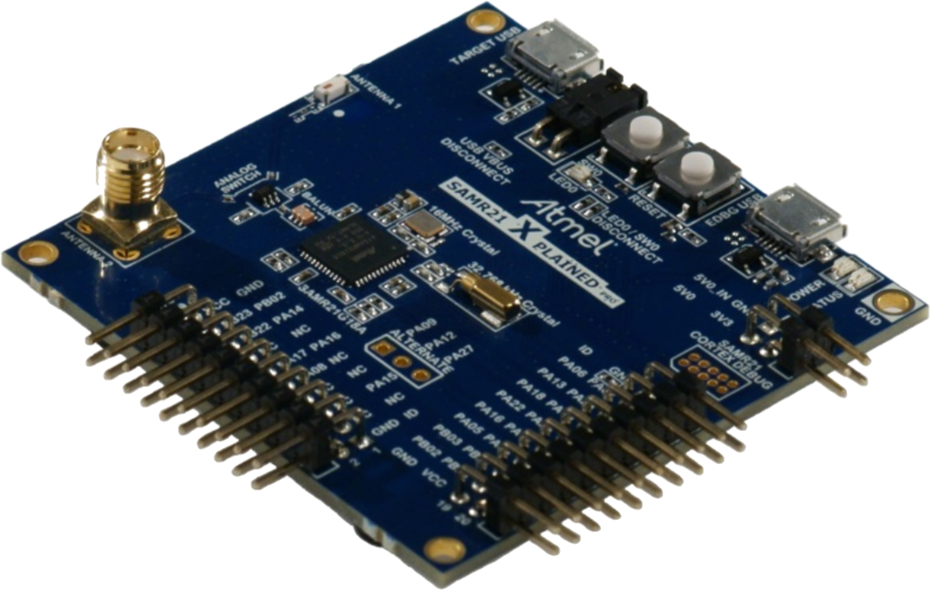
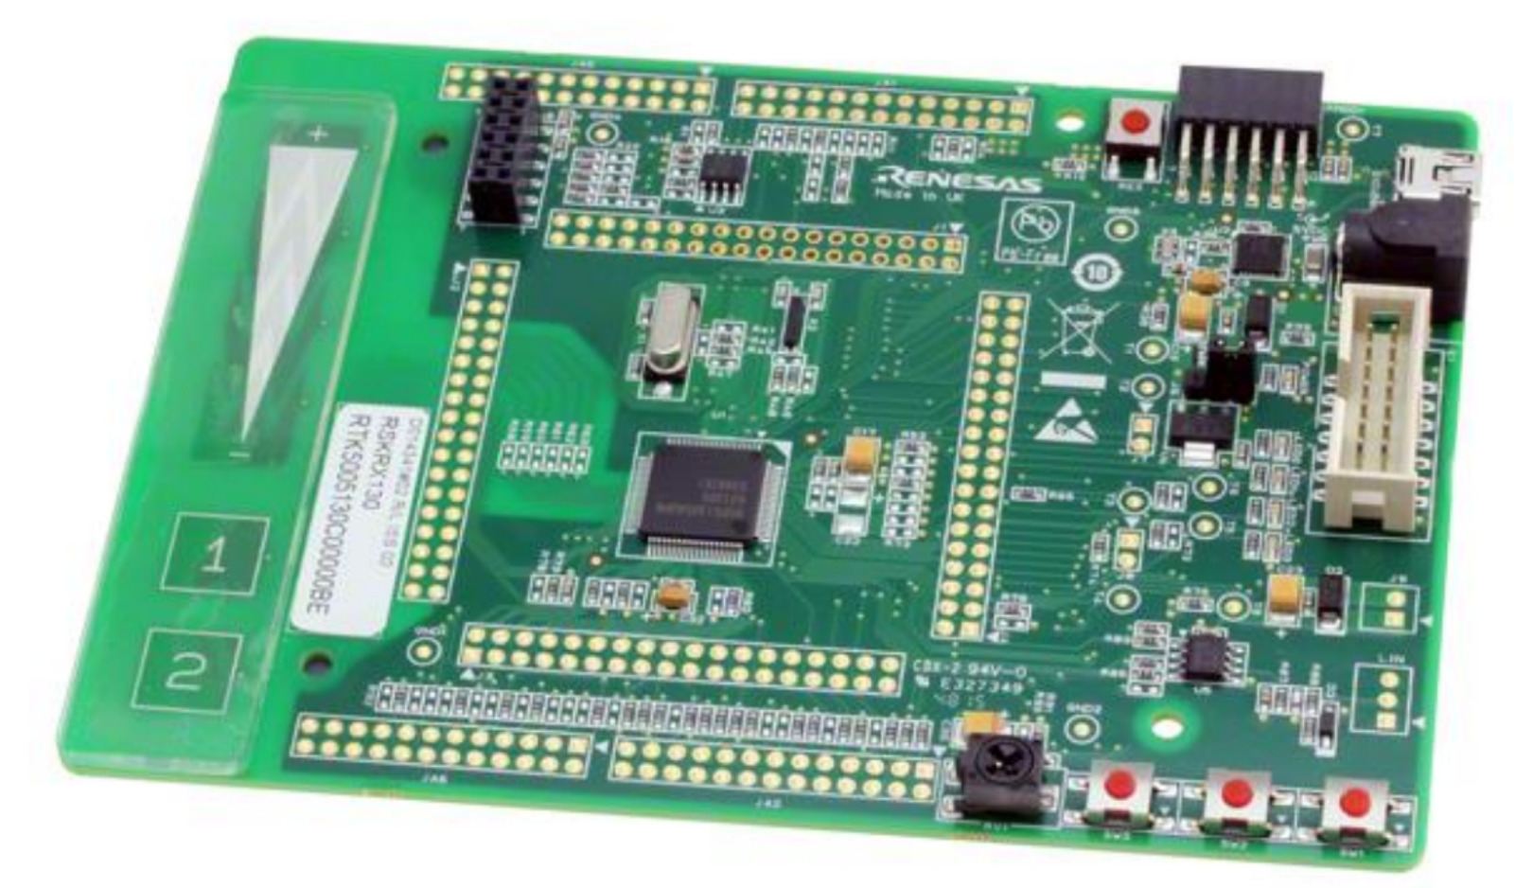

What happened at the Hackathon?
manifest generators!
2 independent implementations (ARM, Renesas)
manifest parsers!
3 independent implementations (Inria/FUB, ARM, Renesas)
2 of which running on micro-controllers
interoperability!
manifest generator (ARM) <=> parsers from Inria/FUB & Renesas
end-to-end workflow demonstrated!
Open source implementation based on RIOT
Microchip SAMR21
Cortex-M0+
32kB RAM, 256kB ROM
Renesas
Starter Kit
RX231
64kB RAM

Slide 4
What did we learned?
The spec should define only one way to do things!

Slide 5
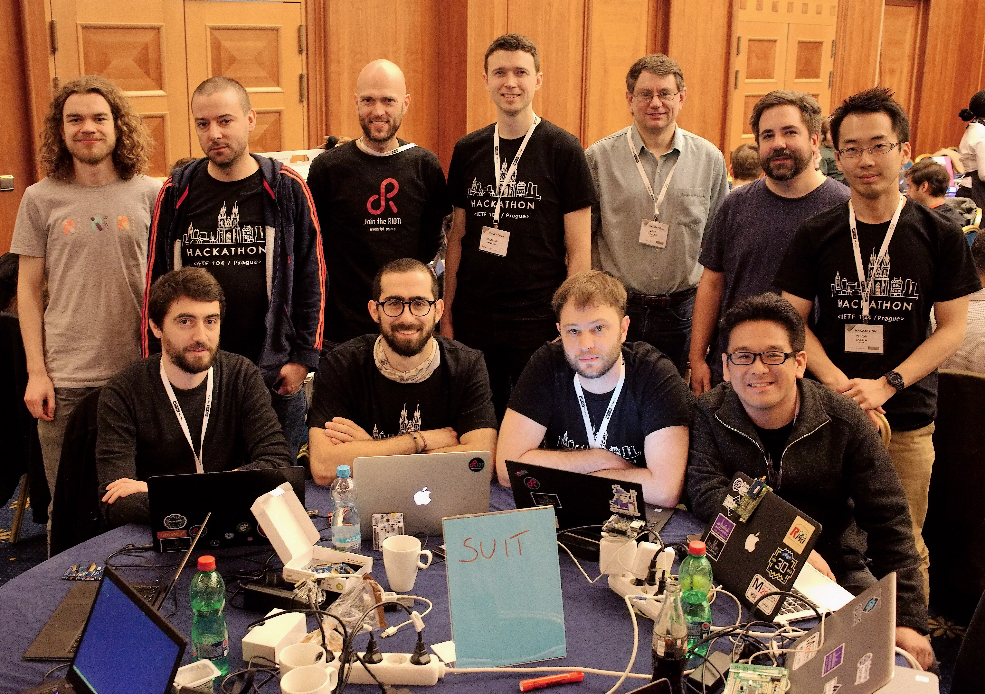
SUIT Hackathon Team!
Brendan Moran
Koen Zandberg
Emmanuel Baccelli
Yuichi Takita
Tadahiko Ito
Kaspar Schleiser
Alexandre Abadie
Francisco Molina
Daniel Petrie
Daniel Petry
Dave Thaler
Dave Waltermire

Slide 6
More info?
IETF SUIT Working Group:
https://datatracker.ietf.org/wg/suit/about/
Manifest draft used:
https://tools.ietf.org/html/draft-moran-suit-manifest-04
Etherpad from Hackathon:
https://etherpad.net/P/ietf104-suit-hackathon

